Slide 1
Immersive Python Workshop
Day 2
Data Visualization

Slide 2
Overall Goals of this Data Visualization Session
See examples of what’s possible
Learn benefits of scripting data visualization tasks
Learn how to read documentation about using Python packages
Get familiar with the process of developing Python scripts locally

Slide 3
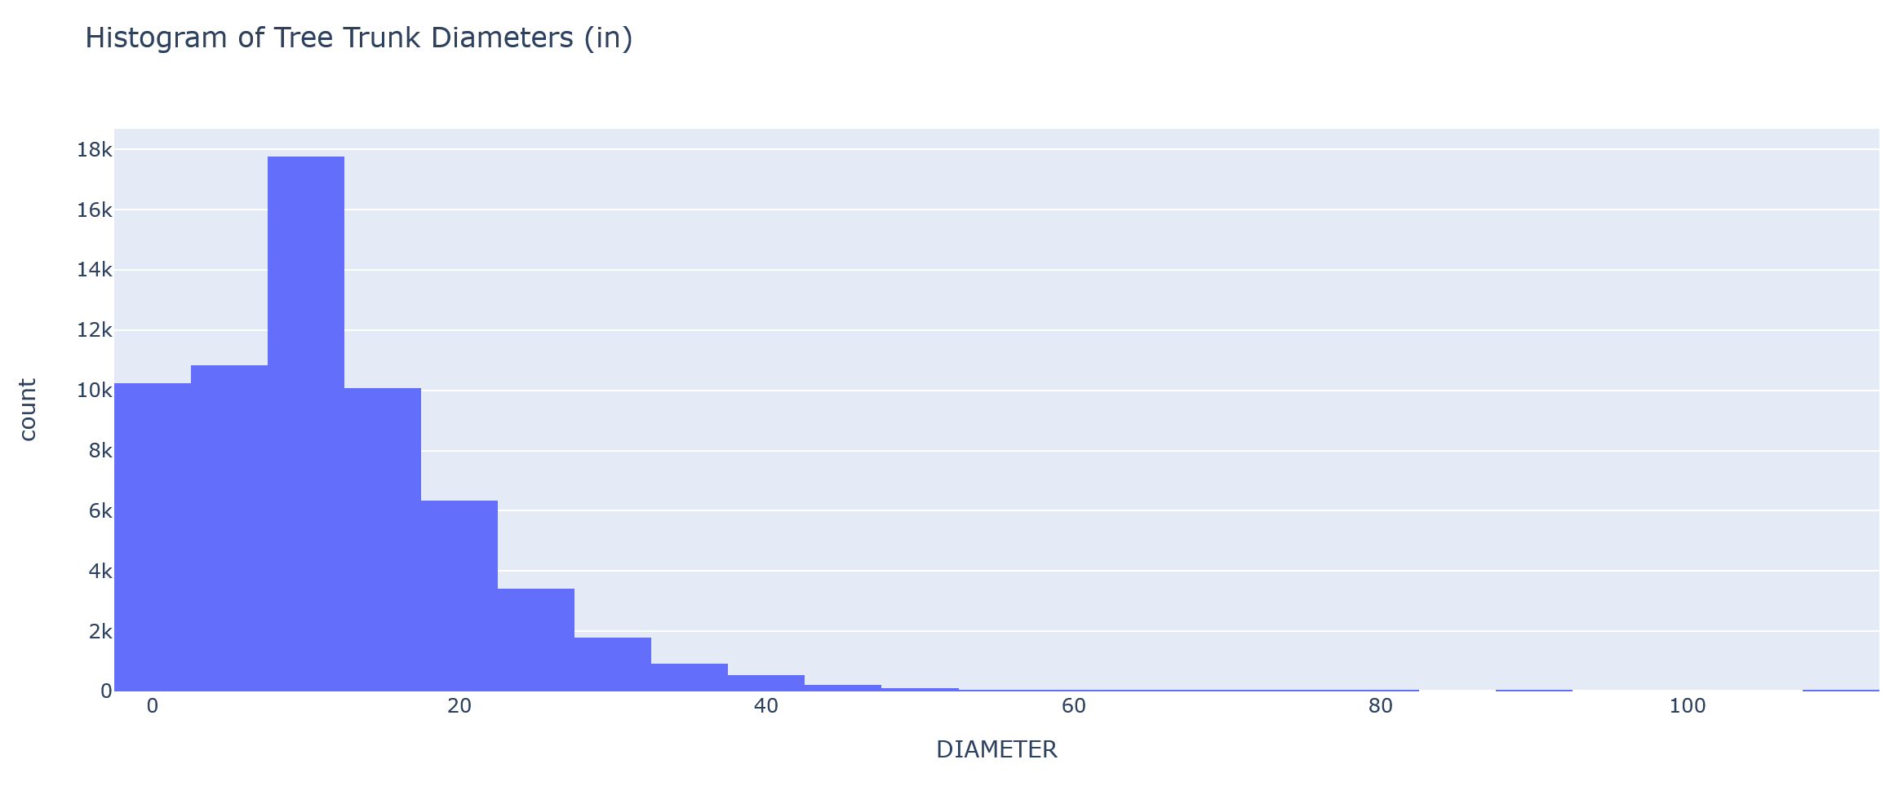
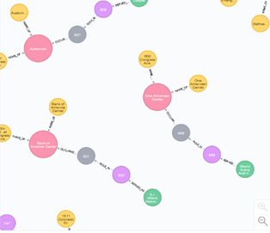
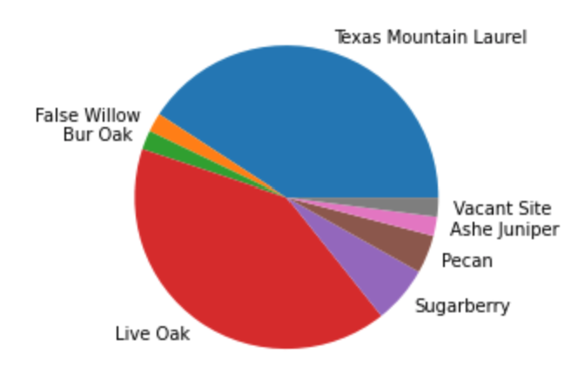
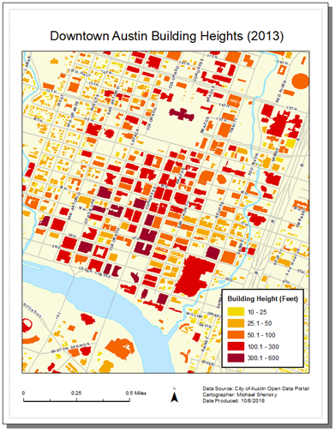
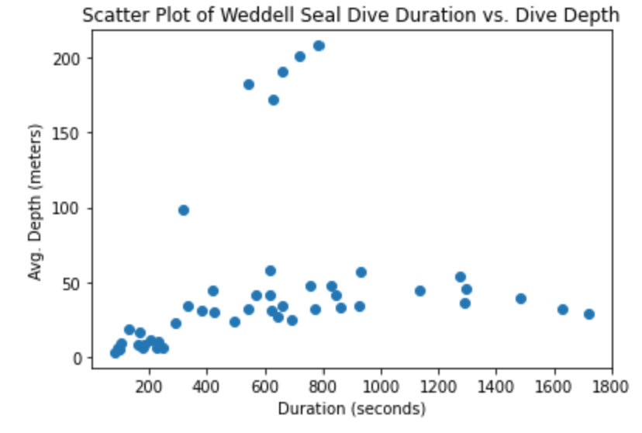
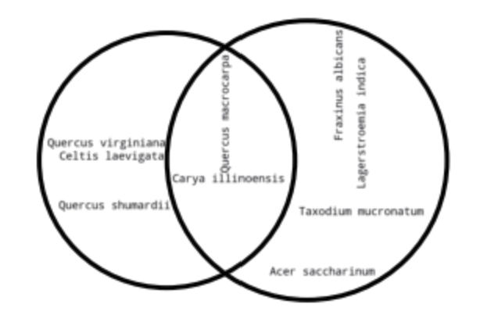
What is Data Visualization?
Graphically representing data to facilitate communication of information
Visualizations often take the form of charts, graphs, maps, and diagrams
Effective data visualization is both an art and science
Can be difficult and time consuming when:
Datasets are large and complicated
Datasets are updated frequently
Large numbers of visualizations need to be created
Multiple styles of a visualization product are required for different audiences

Slide 4
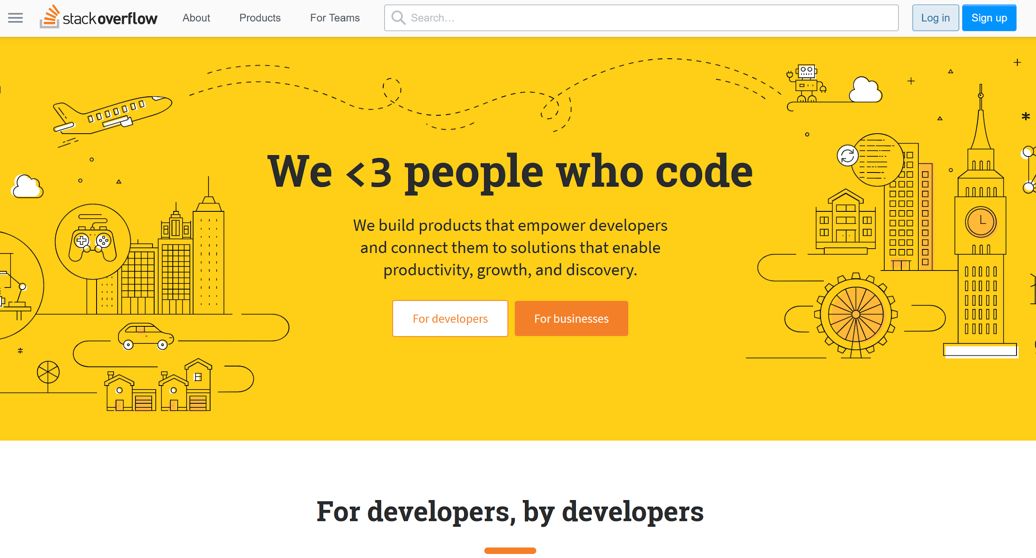
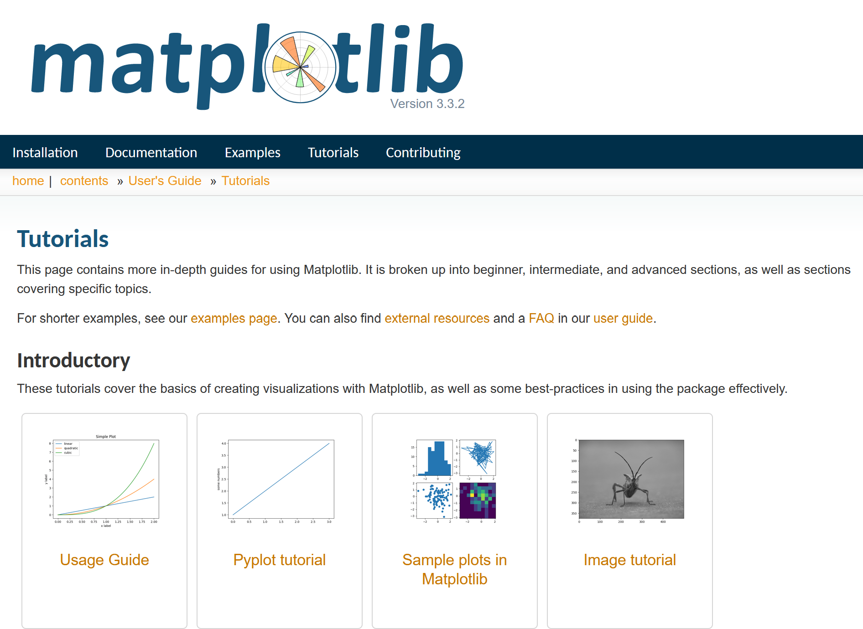
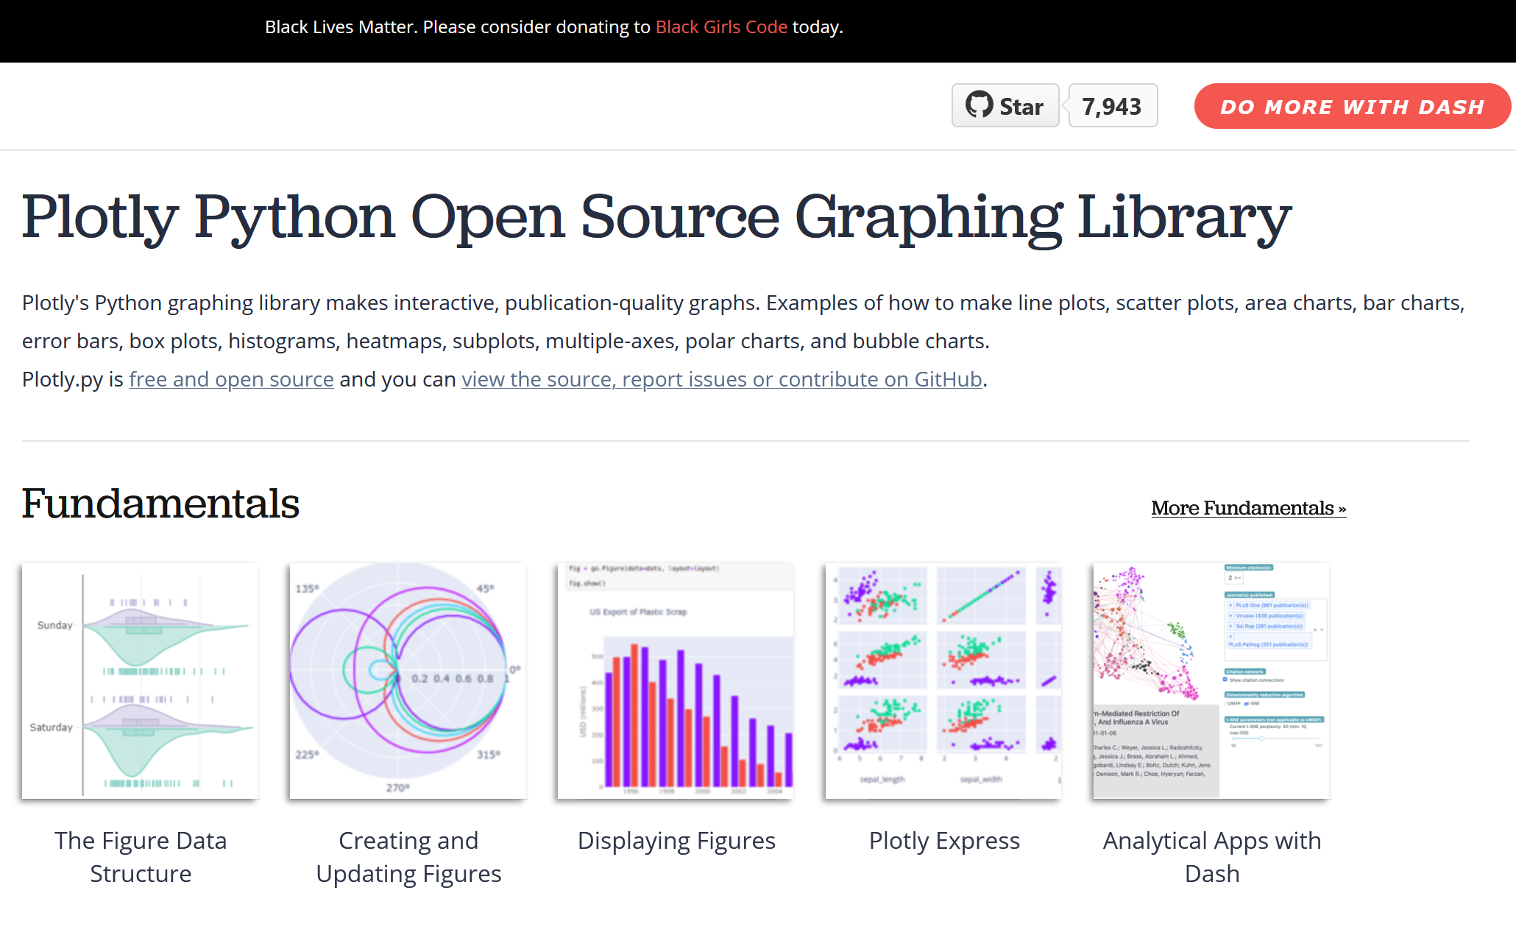
Python Data Visualization Resources
Matplotlib Documentation (https://matplotlib.org/3.3.2/tutorials/index.html)
Plotly Documentation (https://plotly.com/python/)

Slide 5
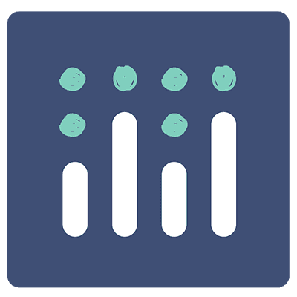

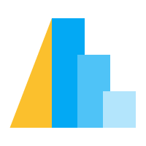


Choosing a Data Visualization Library
Factors to Consider
Static vs. Interactive visualizations
Support for niche visualization types (e.g. maps, networks)
API complexity
API level of control
Popularity
API documentation

Slide 6
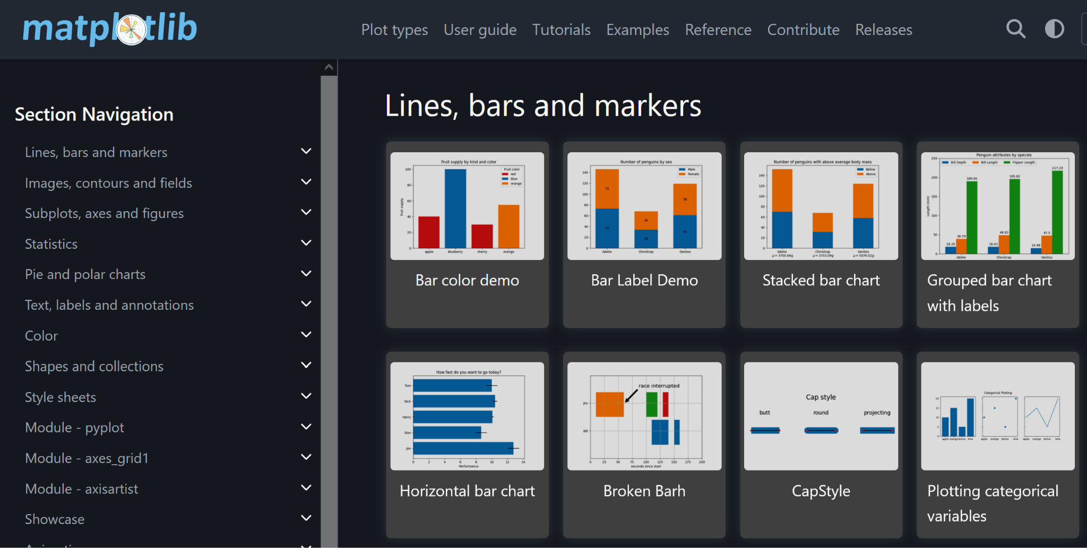
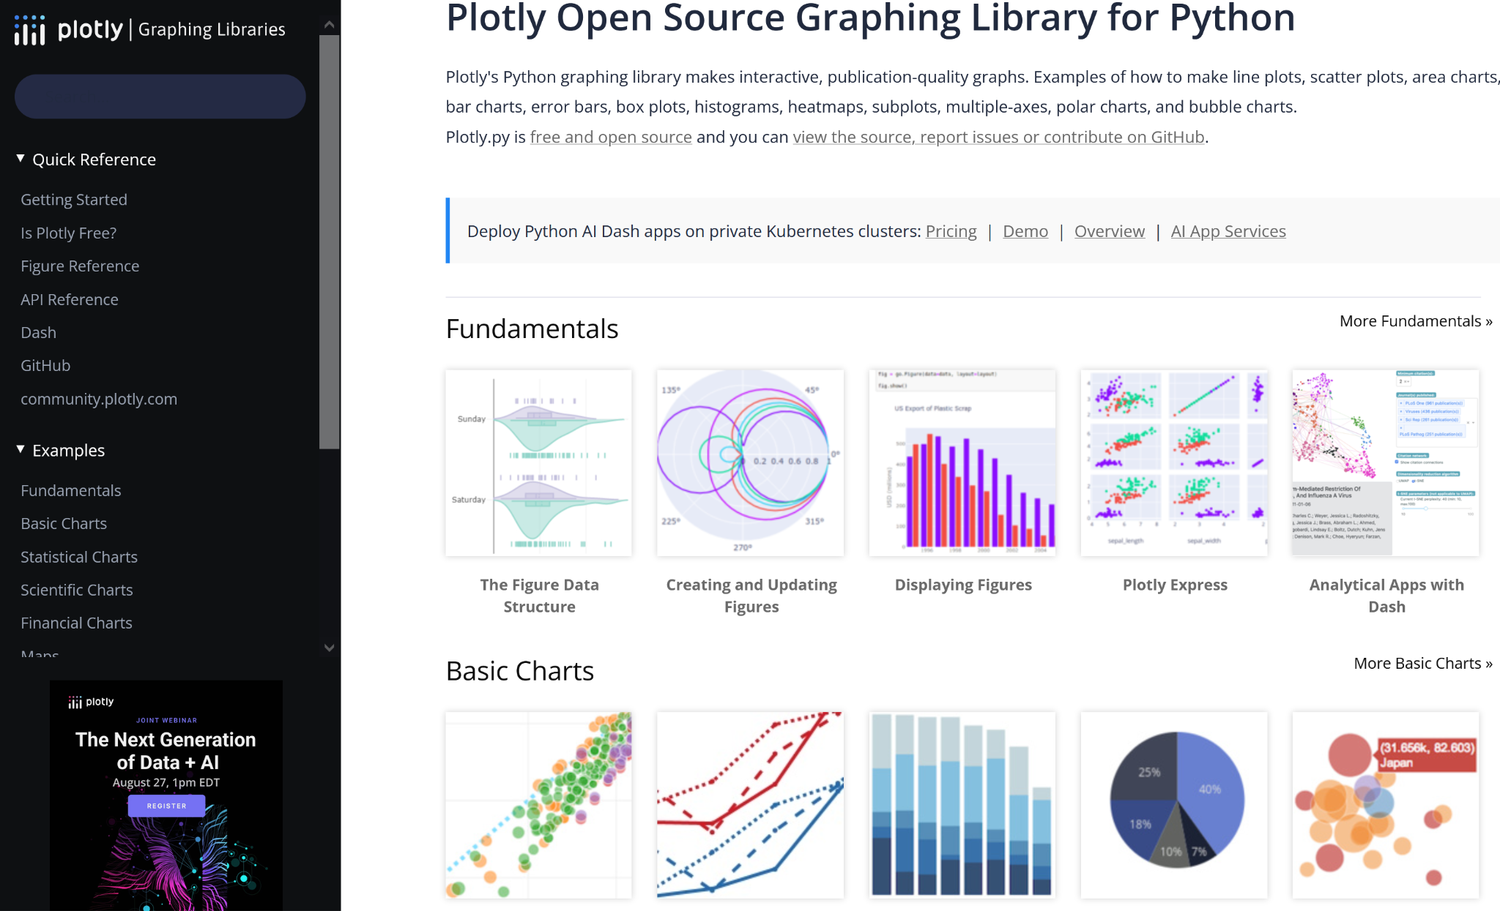
Learn What’s Possible and Get Ideas
Python Data Vis Package Galleries to Visit
https://networkx.org/documentation/stable/auto_examples/index.html
https://plotly.com/python/
https://matplotlib.org/stable/gallery/index.html
https://seaborn.pydata.org/examples/index.html

Slide 7
Python Demo: Visualizing Data with MatPlotLib & Plotly
Installing new packages
Accessing data directly from repositories that can be processed and prepared for visualization
Creating a variety of different chart types including venn diagrams, pie charts, bar charts, and scatter plots
Comparing code for creating simple chart types with different visualization libraries
Reading package documentation to learn how to create and make adjustments to charts and figures

